Slide 1

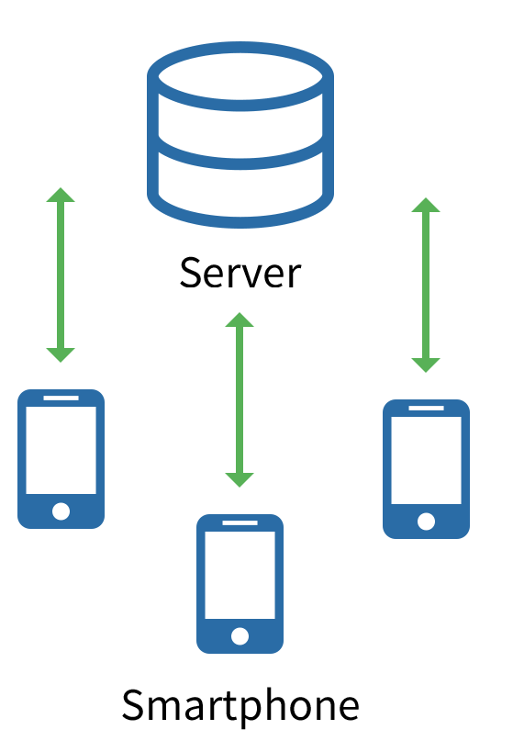
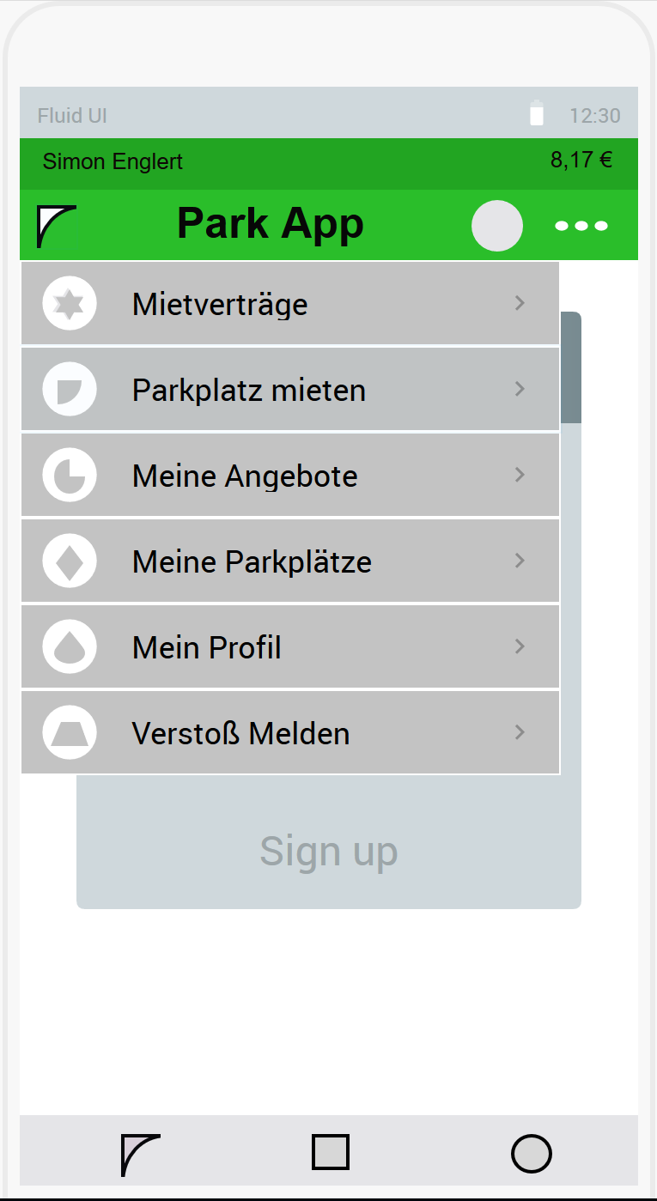
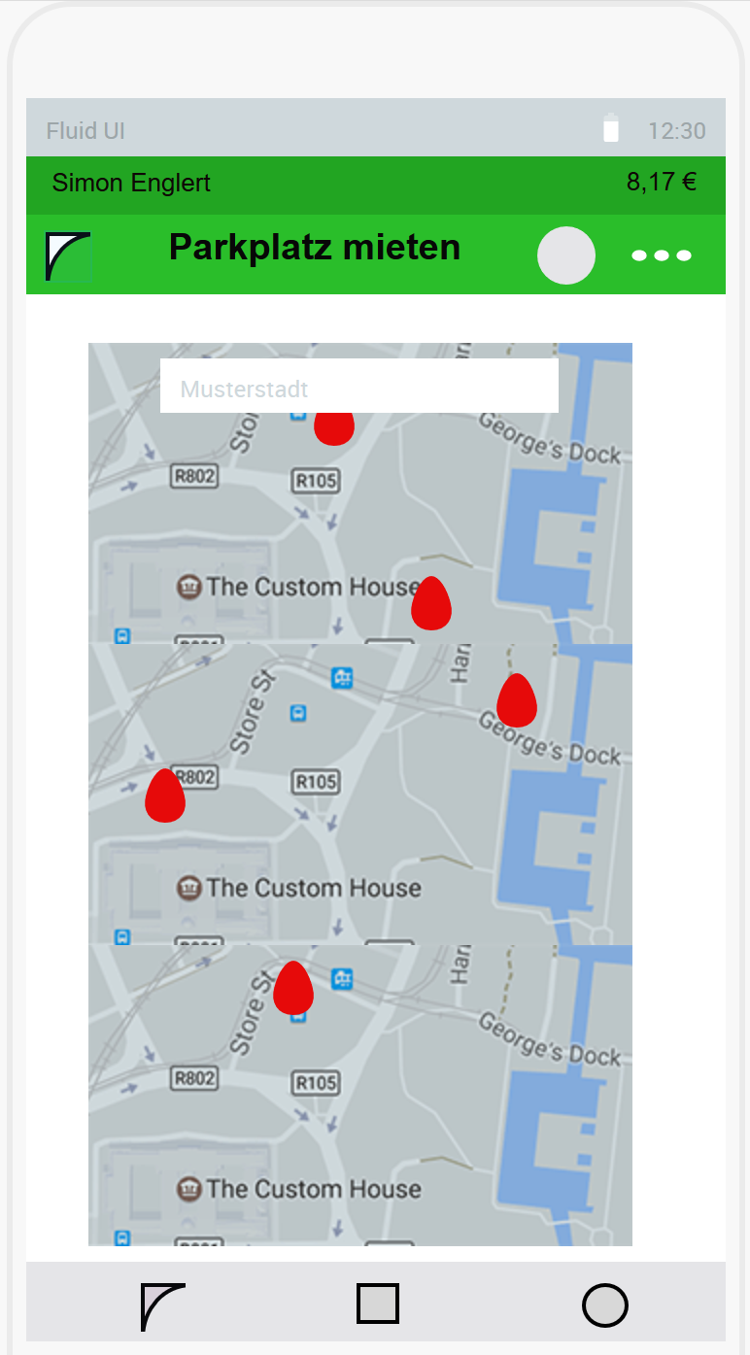


Design of a Shared Parking System
with special attention to security aspects
Simon Englert
Overview
Parking Problem
At first the thesis introduces the parking problem in big cities and presents related work in the field of intelligent parking systems. The main part focuses on the design of a Shared Parking System. This design will also be implemented as an Android App. While the app follows the main suggestions of the design regarding security aspects, there will be different alternatives presented and their respective advantages and disadvantages evaluated. At the end there will be proposals for further work in this area.
As big cities are growing more and more, the parking situation in those cities is becoming more precarious than ever. Parking demand already exceeds the limited amount of parking spaces available, and thus leads to much of the city traffic generated by people searching for a place to park. This leads to frustration with drivers, more traffic jams, unnecessary use of petrol and further air pollution. The creation of new parking spaces is often either difficult or very expansive, which means existing parking spots have to be used more efficiently. With that intelligent parking systems come into play. This work focused on Shared Parking, a special kind of intelligent parking system, which opens the possibility of sharing a parking place between different people. This work features the design of such a system with special attention given to security aspects
The design proposes two fundamental systems to prevent cheating. With the Rating System users can rate their contractual partners and report any violations with a Report System. Those basic systems make sure to eliminate scammers quickly.
Implementation
The Shared Parking System will be implemented after the Server-Client-Model. The server is used as a central database and provides and interface via REST API for the client smartphones which have the app installed. Mock-Up of the App showing the main menu and screen for for the parking spot search.
How to dedect scammers?
How to punish scammers?
How to compensate scammers for the injured party?
Acknowledgement
Special thanks to Prof. Dr.-Ing. Alexandra Dmitrienko from the Secure Software Systems Research Group and the City of Würzburg, who supported this Bachelor Thesis.
Contacts
Simon Englert
simon.englert@stud-mail.uni-wuerzburg.de

